Slide 1
R CASE STUDY
(LOGISTIC REGRESSION)

Slide 2
OBJECTIVE
To predict whether or not it will rain tomorrow by training a binary classification model on target `RainTomorrow’.
- The target variable `RainTomorrow’ means: Did it rain the next day? Yes or No.
#Note- Exclude the variable `Risk-MM’ when training the binary classification model. Not excluding it will leak the answers to the model and reduce its predictability.

Slide 3
VARIABLES
Date
Location
MinTemp
MaxTemp
Rainfall
Evaporation
Sunshine
WindGustDir
WindGustSpeed
WindDir9am
WindDir3pm
WindSpeed9am
WindSpeed3pm
Humidity9am
Humidity3pm
Pressure9am
Pressure3pm
Cloud9am
Cloud3pm
Temp9am
Temp3pm
RainToday
RISK_MM
RainTomorrow

Slide 4
PROCESS
Since, some variables like wind direction, wind speed, humidity etc. are given for both 9am and 3pm, we’ll create two separate models.
Model1 – For 9 am variables
Model2- For 3 pm variables

Slide 5
CHANGING DATA STRUCTURE
Rain Today and Rain Tomorrow into factor with levels 0 and1.
- Using as.Date function to convert Date from string to Date format.

Slide 6
CHECK FOR NA VALUES
316559 NA values in total.
Replaced the numeric NA values with the means of their respective colomns.
Omitted the Factor NA values by na.omit().

Slide 7
VISUALISATIONS
HISTOGRAMS
2. CORRELATION PLOT

Slide 8
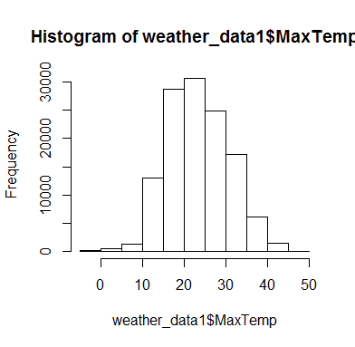

Slide 9
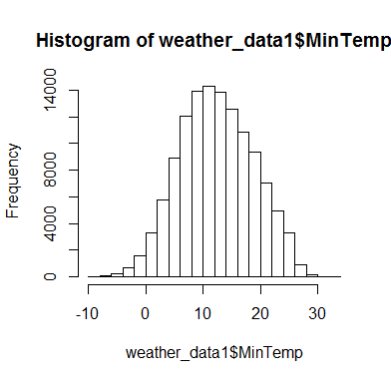

Slide 10
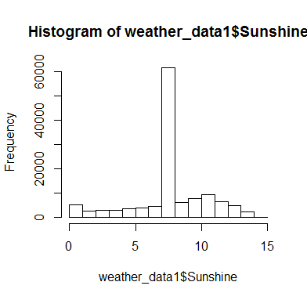

Slide 11
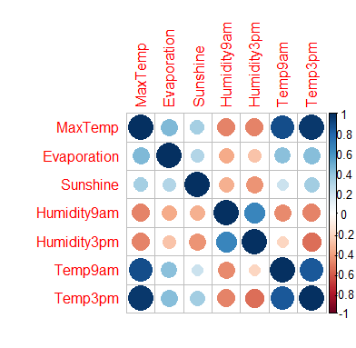
CORRELATION PLOT
Since, we found a high degree of correlation between MaxTemp and Temp9am as well as between MaxTemp and Temp3pm, therefore we’ll use either of the two in both the models.
##We’ve used MaxTemp.

Slide 12
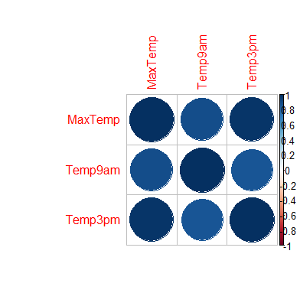
CORRELATION BETWEEN MAXTEMP, TEMP9AM AND TEMP3PM

Slide 13
MODEL 1
Variables used:
Y - RainTomorrow
X - Location ,MaxTemp, Evaporation, Sunshine, WindGustDir, WindGustSpeed, Humidity9am,
Cloud9am, RainToday.

Slide 14
Splitting the dataset into training and testing data in
the ratio 4:1, and calling:
glm(formula = RainTomorrow ~ ., family = "binomial", data = data_train1)
RESULTS:
Degrees of Freedom: 98968
Total (i.e. Null); 98900 Residual
Null Deviance: 104700
Residual Deviance: 78200
AIC: 78340
## Using a threshold value of 0.4, accuracy is 0.822117133503092.

Slide 15
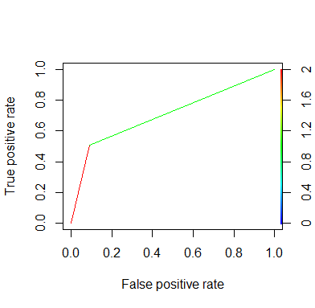
ROCR Performance
The area under the curve comes out to be 0.7145025.
True / False: Actual
+ve/ -ve: Predicted

Slide 16
MODEL 2
Variables used:
Y - RainTomorrow
X - Location ,MaxTemp, Evaporation, Sunshine, WindGustDir, WindGustSpeed, Humidity3pm,
Cloud3pm, RainToday.

Slide 17
Splitting the dataset into training and testing data in
the ratio 4:1, and calling:
glm(formula = RainTomorrow ~ ., family = "binomial", data = data_train2)
RESULTS:
Degrees of Freedom: 98968
Total (i.e. Null); 98900 Residual
Null Deviance: 104700
Residual Deviance: 69930
AIC: 70070
## Using a threshold value of 0.4, accuracy is 0.84313487732913.

Slide 18
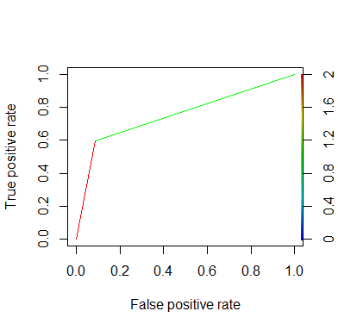
ROCR Performance
The area under the curve comes out to be 0.7245595.
True / False: Actual
+ve/ -ve: Predicted

Slide 19
CONCLUSION
MODEL 1:
Using a threshold value of 0.4,
accuracy is and 0.822117133503092
Area under the curve is 0.7145025
MODEL 2:
Using a threshold value of 0.4,
accuracy is 0.84313487732913 and
Area under the curve is 0.7245595

Slide 20
CONTRIBUTORY:
Nisha Sharma
Economics Honors, 3rd year
Miranda House, DU

